Slide 1
Neural Network
Shreenidhi S
Fall 2016

Slide 2
Introduction
Supervised Learning Algorithm
Classification and Regression
High Prediction Accuracy
Deep Learning

Slide 3
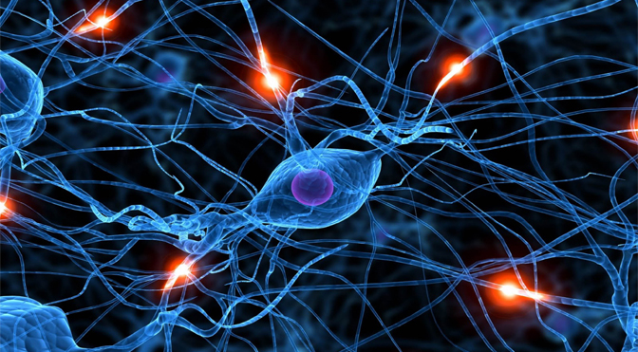
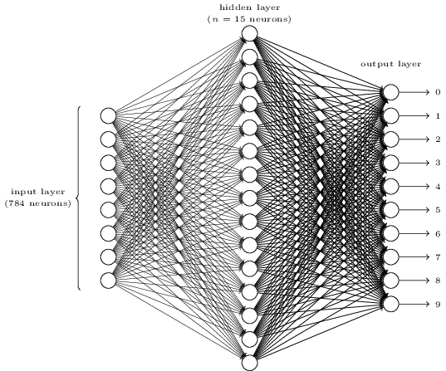
Neural Network
Nervous System
3 Layer Neural Network

Slide 4
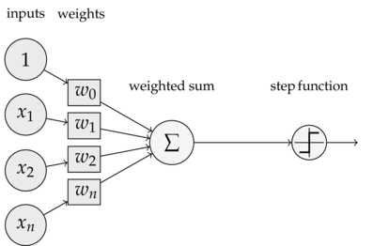
Perceptron

Slide 5
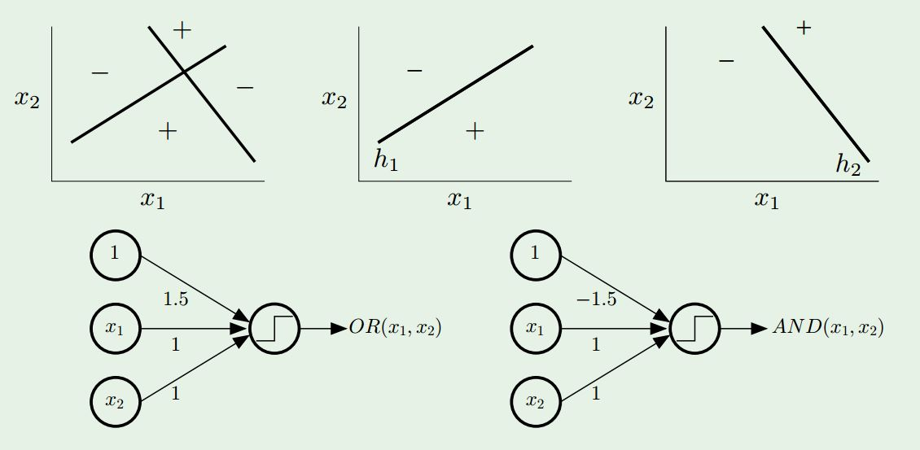
Failed Attempt
[1] # of Perceptron Increases as Non-Linearity of Data Increases

Slide 6
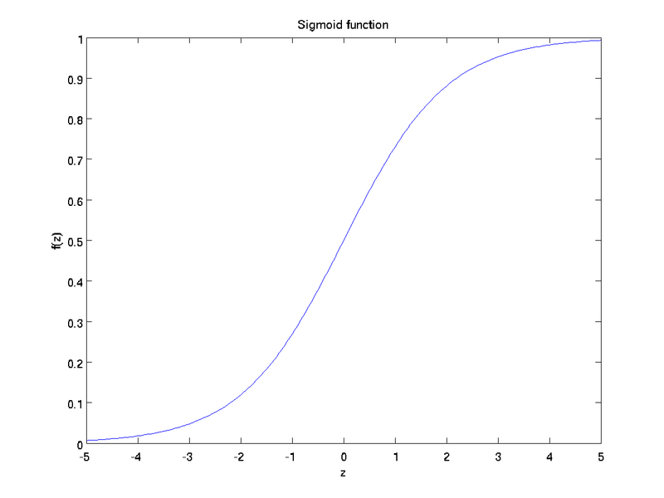
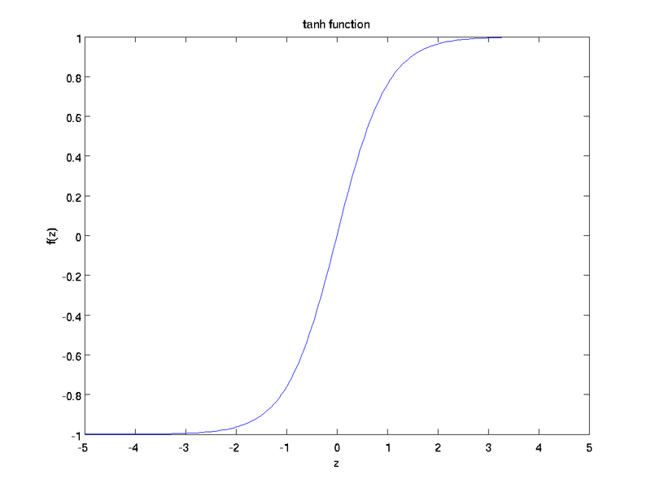


Activation Function

Slide 7
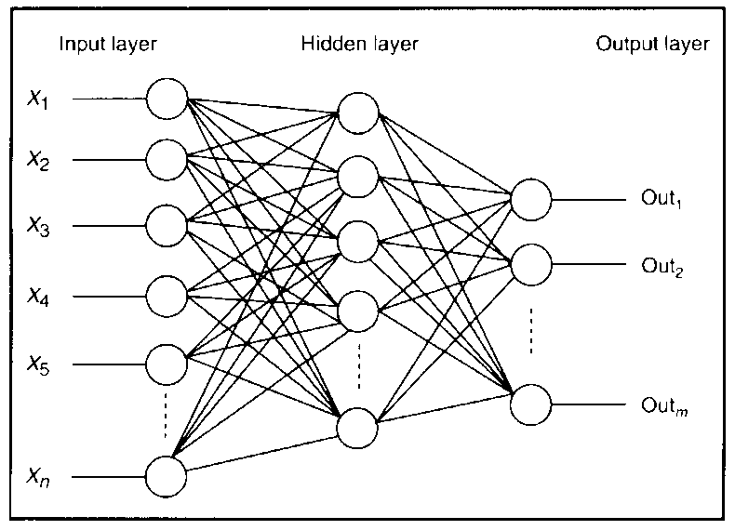
Model of Neural Network

Slide 8
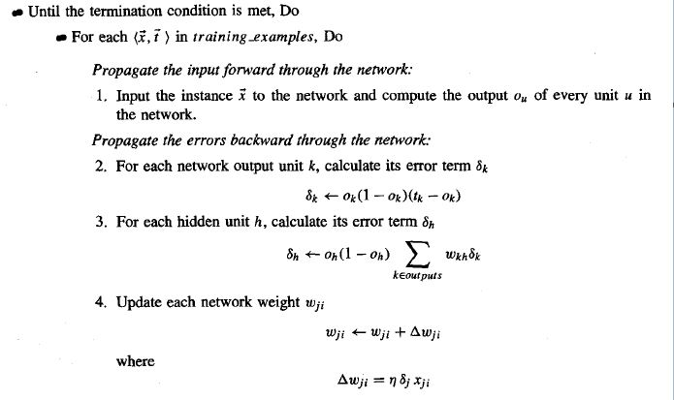
Back Propagation Algorithm

Slide 9
Gradient Descent
Batch Gradient Descent
Ideal for large datasets
Weight values are updated after 1 epoch
Stochastic Gradient Descent
Ideal for small datasets
Weight values are update after 1 data sample

Slide 10
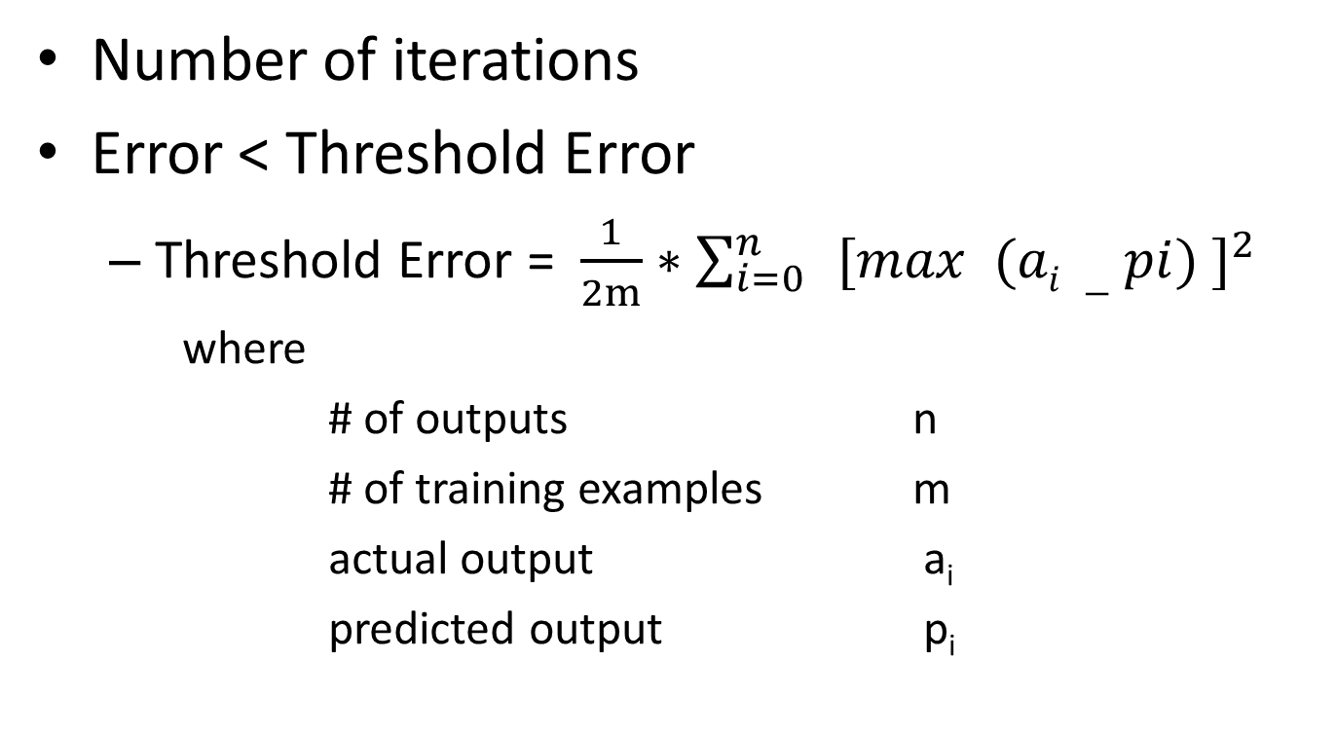
Stopping Criterion
Number of iterations
Error < Threshold Error
Threshold Error = $\frac{1}{2m}∗\sum_{i=0 }^{n}{ [max ({ai −pi) ]}^{2}}$
where
# of outputs n
# of training examples m
actual output a_{i}
predicted output p_{i}

Slide 11
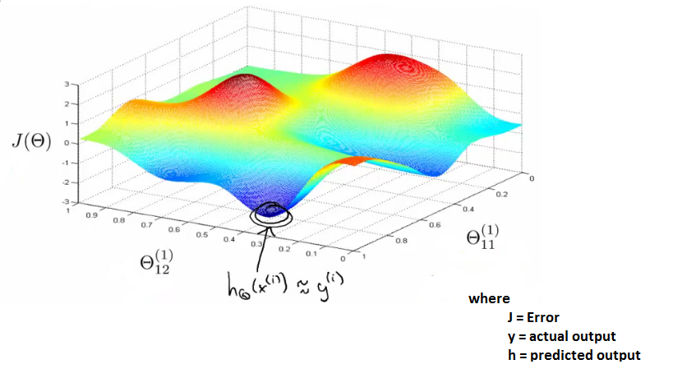
Local Minima

Slide 12
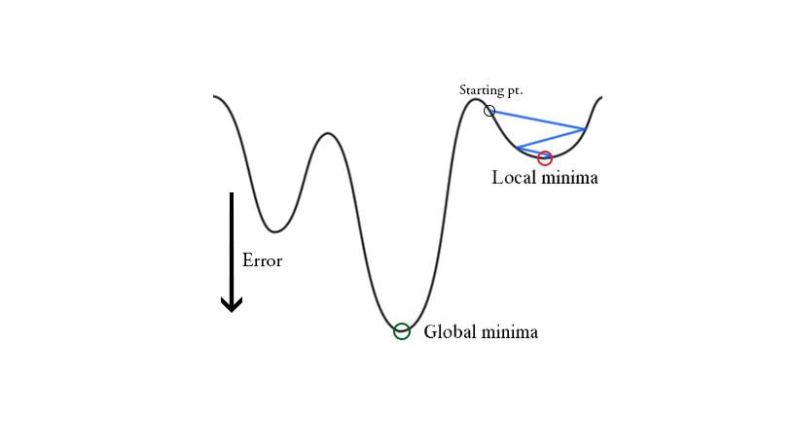
Choose Learning Rate Wisely

Slide 13
Chosen Dataset
Iris
Features : 4
Class Labels : 3
Data Samples : 150
Car Evaluation
Features : 6
Class Labels : 4
Data Samples : 1728

Slide 14
Results – Batch Gradient Descent
Iris
Car Evaluation
Accuracy
Validation
Test
Accuracy
Validation
Test

Slide 15
Results - Stochastic Gradient Descent
Iris
Car Evaluation
Accuracy
Validation
Test
Accuracy
Validation
Test

Slide 16
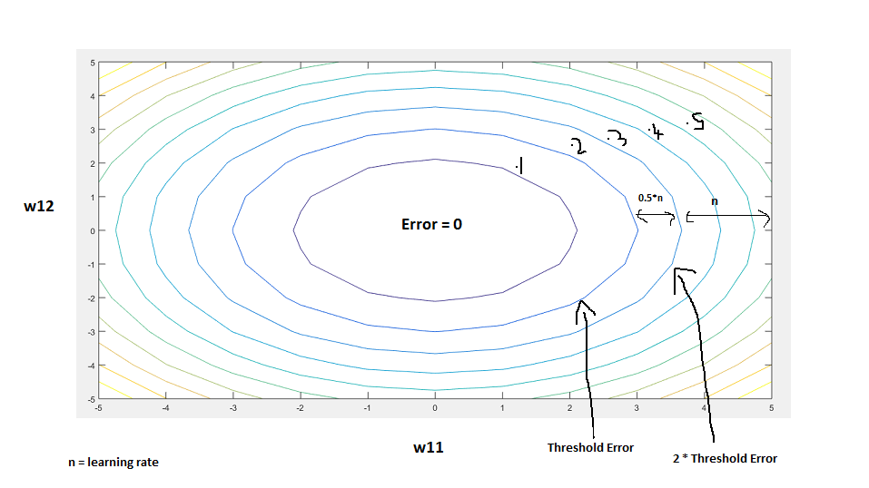
Variable Learning Rate
if (error < 2 * Threshold Error) Learning Rate = 0.5 * Learning Rate;

Slide 17
Results
Iris Data Set
Learning Rate | Stochastic |  | Batch
 | Conventional | My Approach | Conventional | My Approach
0.1
0.2
0.3
Car Evaluation Data Set
Learning Rate | Stochastic |  | Batch
 | Conventional | My Approach | Conventional | My Approach
0.1
0.2
0.3

Slide 18
Conclusion

Slide 19
Thank You

